Slide 1
Temperature controlled fan
Group members:
Abbiha Mustafa 28855
Syeda bisma arooj 30307

Slide 2
Description
The main aim of this project is to calculate and monitor the surrounding temperature and change the speed of the fan as temperature changes i.e. the speed should increase with a rise in temperature and should decrease with a drop in temperature. The temperature would be displayed through the LCD, which is interfaced by the 8051 microcontroller. The FAN is controlled by a PWM wave given to it by the microcontroller, the power given to the fan is lesser in low temperature and greater in high temperature.

Slide 3
Objectives:
The objective of this project is to make a Fan, whose speed is controlled by temperature. The idea behind the project is that we have a temperature sensor which senses the temperature and give the output in analog form which then is fed to ADC to convert it to digital signal (with values in HEX format), the output of ADC is given to the microcontroller. Now according to the temperature we are going to control speed of the dc-fan that depends on the technique Pulse width modulation, as the width varies, the delay varies because of that the speed of the fan varies accordingly.

Slide 4
Benefits:
By controlling, the speed of the fan at different temperatures we save a lot of energy throughout the day. Instead of a fan running at full speed all day, which requires a lot of energy, if the speed is controlled and given, as necessary we can save a lot of energy.

Slide 5
working
The main principle behind the working is PWM i.e. pulse width modulation.
It is a technique for controlling the power output given to different electric devices.
The average value of voltage (and current) fed to the load is controlled by turning the switch between supply and load on and off at a fast pace. The longer the switch is on compared to the off periods, the higher the power supplied to the load is.
So if the switch is on for a longer time then more power will be delivered to the fan and it will rotate faster.
We can program the microcontroller in such a way that when the temperature is higher, the switch remains on for a longer duration and when it is lower, switch remains on for a shorter duration.

Slide 6
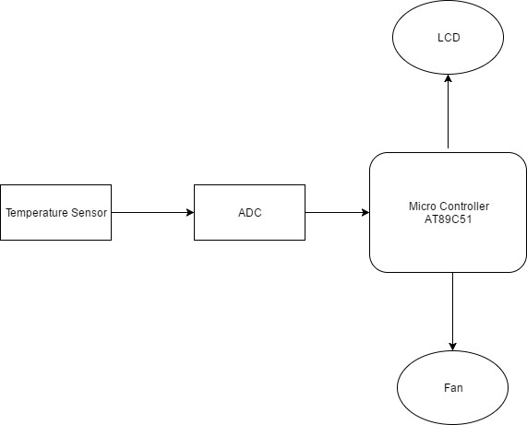
Block diagram:

Slide 7
Components required:
Microcontroller AT89C52
ADC0804
16*2 LCD Display
Temperature Sensor LM35
Resistors
Capacitors
Diodes
Crystal Oscillator 12MHz
Electric Fan
Voltage Regulator (7805)
Potentiometer (10K)

Slide 8
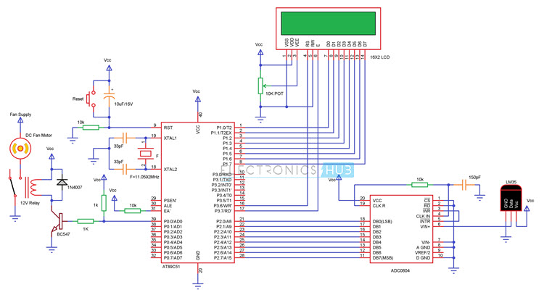
Circuit Diagram

Slide 9
Temperature sensor (LM-35)
The LM35 is a temperature sensor with precession whose output voltage varies depending on the temperature around it. It's a small integrated circuit that can test temperatures from -55°C to 150°C.
If the temperature is 0 degrees Celsius, the output voltage would also be 0 degrees Celsius. For every degree Celsius increase in temperature, the voltage will rise by 0.01V (10mV). The voltage can convert into temperature using the formulae.
V_{out} = 10mv/°C × T

Slide 11
This is would be written in Assembly Language and implemented on Proteus, we will also try to create a hardware model using the mentioned components.
Source: nevonprojects.com
Thank you!

